Slide 1
n-Queens Solver
Thomas Burlett

Slide 2
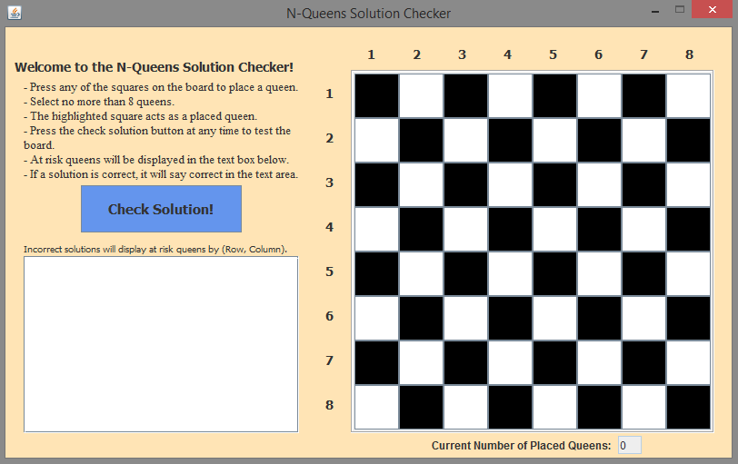
Design Decisions

Slide 3
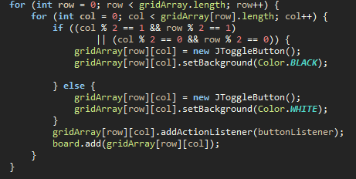
The Board
Simultaneously filled 2D array for later use and created the toggle buttons
2D array helped to keep track of button positions on the grid

Slide 4
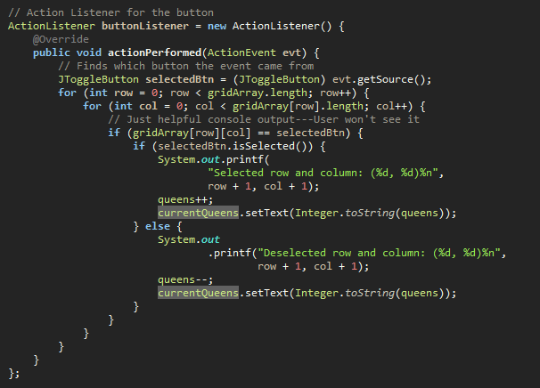
The Board
Toggle Button Action Listeners
Console output was just a helpful debugging tool. Does not affect user experience.

Slide 5
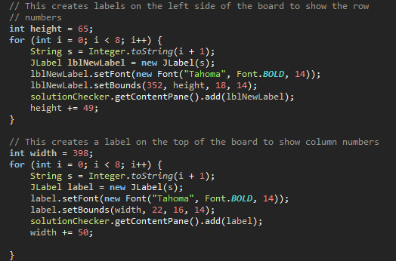
The Labels Surrounding the Board
Easiest and shortest way to display helpful location labels for the user

Slide 6
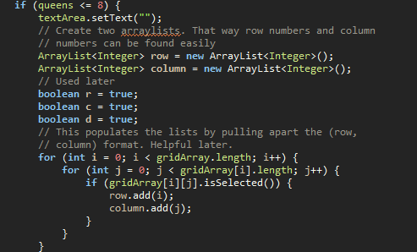
The Check Solution Button
First Part of the ActionListener
Basic steps to prepare for checking the actual board

Slide 7
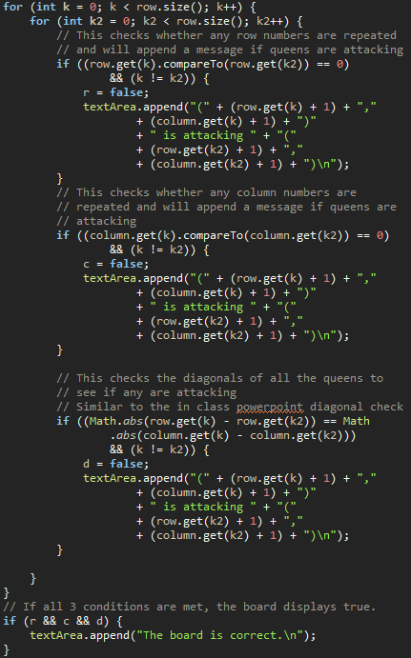
The Check Solution Button
Uses the ArrayLists in the last slide to check rows, columns, and diagonals
Checks the ArrayList for repeated values within the respective directions
The Check Solution Button

Slide 8

Challenges Faced
Pinpointing the specific location of each toggle button on the grid.
Recursive backtracking would have been helpful, but I could not get it to work.
Having the text area display only one error for when two queens are attacking
Example: (1,1) is attacking (2,4)
(2,4) is attacking (1,1)

Slide 9

What I Learned in Boating School is…
Recursion would have eliminated the need for nested for loops in order to check my 2D array of ToggleButtons
GUIs make relatively complex tasks look simple to the user

Slide 10
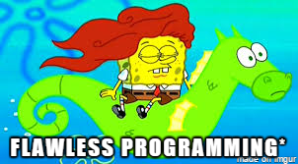
Interesting Features
Everything
Whenever a user selects more than 8 queens, a popup will appear telling them to fix it.
Running total of current number of selected queens.
*Except for some of the flaws

